Slide 1


Slide 2




Team
Ahmed Bilal
Zhuoran Yu
Likhitha Kurella
Chu-Chun Ku

Slide 3





AGENDA
Business Problem
High dropout rates limit career progress
Objectives
Improve retention, connect to tech roles
Data & Tools
DPI Data sets ,Tableau ,R , python and streamlit
Project 1 :
Interactive Dashboard & Key findings
Descriptive and Diagnostic Insights
Project 2:
Tech Role Identification
Project Reflections & Q&A Reflections

Slide 4






Research Objectives
Tech Roles Mapping
Link local jobs to student skills
Retention Strategies
Reduce dropout, boost support
Understand Dropouts
Explore reasons by student background

Slide 5
Data Sources & Tools
Data Sources
Tools Used
DPI student demographics
Streamlit for apps
Tech experience metrics
Tableau for visualization
Web-scraped job data
R & Python for modeling
Excel for data cleaning

Slide 6

Project 1 - Student Retention Analysis

Slide 7




Business Problem
Student Challenges
Dropout Impact
Key Questions
Diverse backgrounds but unclear pathways into tech
High rates limit meaningful career progress
What triggers dropout? How to enhance retention?

Slide 8

Hypotheses
Module Variation
Performance varies among course modules based on industry and
years of experience
Technical Experience
Non-tech backgrounds face higher dropout risks
Income level
High and low income groups tend to engage less with the course.
Industry Influence
Prior careers affect tech transition challenges

Slide 9
Descriptive Analysis

Slide 10
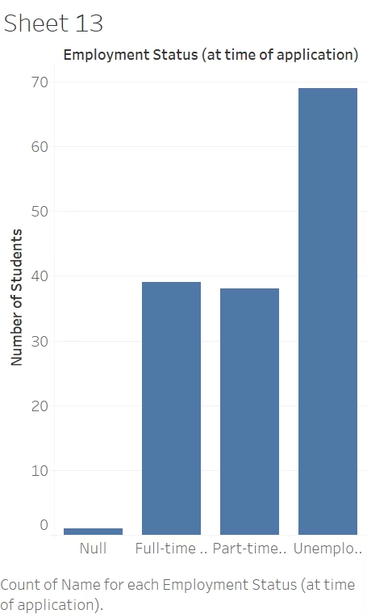
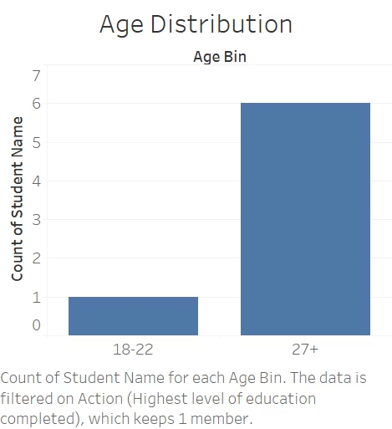
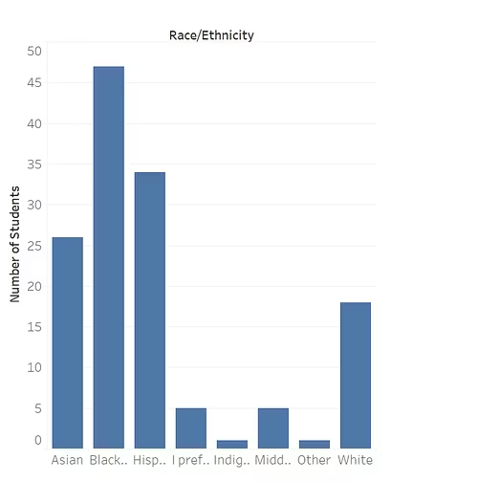



Student Diversity Profile
Professional Experience
Most have 10+ years experience
Racial Diversity
Employment Status
Major groups: Black, Asian, White
Majority unemployed at enrollment

Slide 11
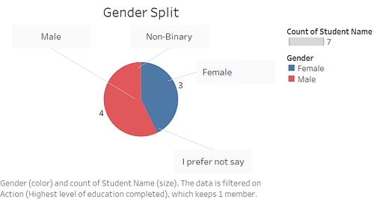
Student Demographics
27+
Average Age
Most learners are adults with established careers
146
Male Students
Largest gender group in the program
111
Female Students
Second largest gender demographic
91
Bachelor's Degrees
Most common education level

Slide 12
Diagnostic Analysis

Slide 13

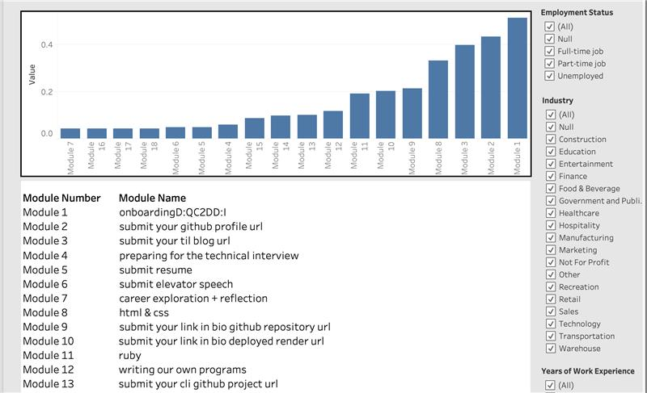



Module Analysis
Ranks the modules in terms of low to high completion rates
Module 7, 16, 17, 18, 6 and 5 with lowest completion rates
The graph allows interactive features to see how learners with different industry backgrounds, income levels and work experience engage with different modules of the course
Modules which require submission are the least completed whereas initial modules relating to system setup are completed most.

Slide 14
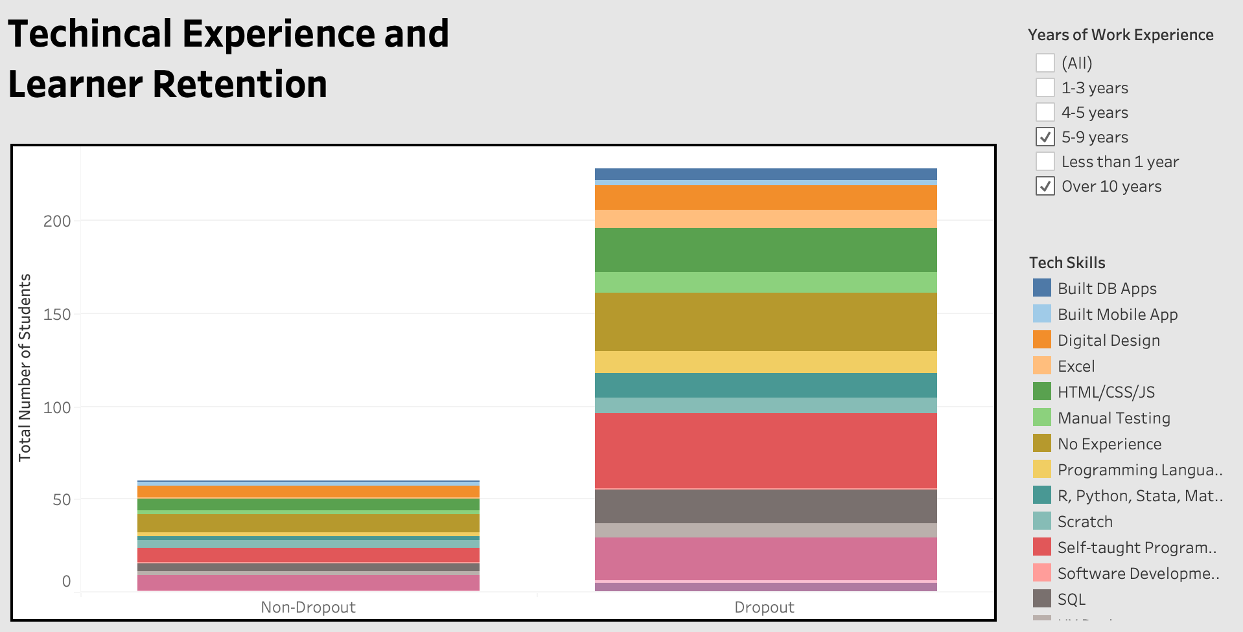
Technical Skills and Learner Retention
Gives an overview of low retention for learners with
different technical skills background
Learners with self-taught programming and No prior technical experience have high drop-out frequency
Students with HTML/CSS/JAVA skills also have high drop out frequency even with a module that requires application of these skills
Even students with backgrounds in SQL, Software Development, and UX Design dropped out.

Slide 15
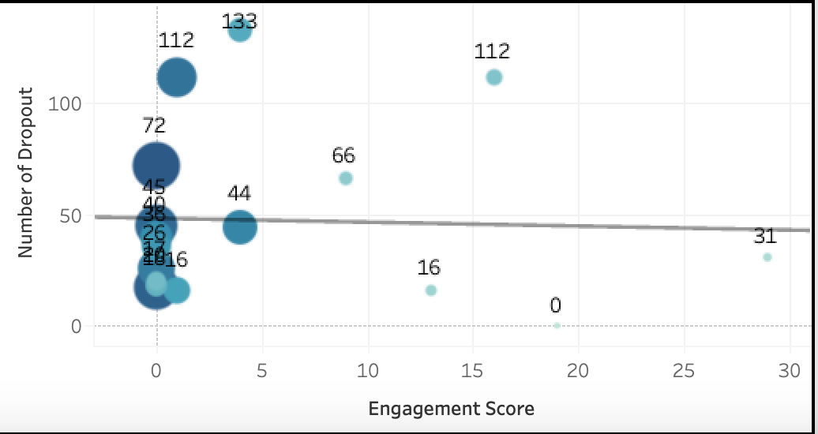
Engagement Score and Learner Retention
Basic correlation analysis of relation between Engagement
Score and Retention Numbers
Purpose was to see if Staff Interactions and Engagement Levels have an effect on retention numbers other than learner demographics
Engagement Helps Retention: Groups with engagement scores above 15 have significantly lower dropout counts, including one group with 0 dropouts and others with minimal losses.
Anomalies Exist: Some groups with moderate engagement (like scores around 9 or 10) still see high dropout counts (e.g., 66), suggesting that engagement alone may not explain all dropouts—external factors could be at play.

Slide 16



Key Analysis Findings
Module Analysis
Learners with a background in the construction industry are more likely
to discontinue the course, while those from a tech background tend to persist
Work experience
Individuals with less than one year of work experience
are not completing the final course modules, particularly
those related to submissions, closer to the course's end
Experience Impact
Learners with less experience prioritize career
enhancement modules (4, 5, and 6) more than
their highly experienced peers..

Slide 17
Key Analysis Findings
Participation Challenges
Dropouts span all experience levels, indicating that both beginners and seasoned learners may face challenges due to course pace, expectations, or personal circumstances.

Slide 18








Strategic Recommendations
Industry Fit
Submission Support
Tailor course content for diverse backgrounds. Use construction-relevant examples and tech mentors to aid transition
Guide low-experience learners with final modules. Offer walkthroughs, mini-milestones, and flexible deadlines.
Career Boost
Smart Nudges
Highlight career modules for early professionals. Add coaching, success stories, and networking support.
Use behavior-based alerts and reminders. Deploy email nudges and course bots to encourage progress.

Slide 19
Project 2 – Tech Role Identification in Chicagoland

Slide 20
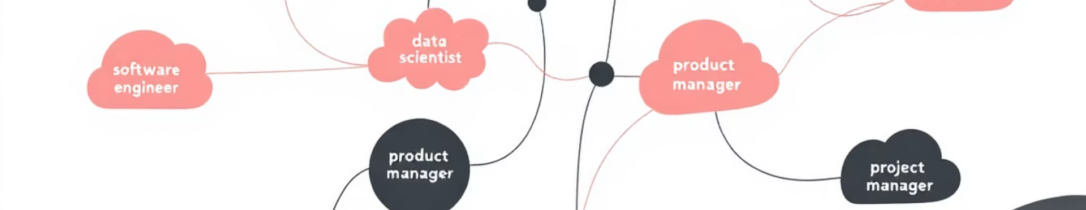



Business Problem
Identify High-Demand Tech Roles
Analyze Employer Skill Requirements
Create Interactive Dashboard
Document the most frequently requested technical competencies.
Support decision-making through data visualization and skill matching.
Predict market trends to optimize resources and guide career development.

Slide 21
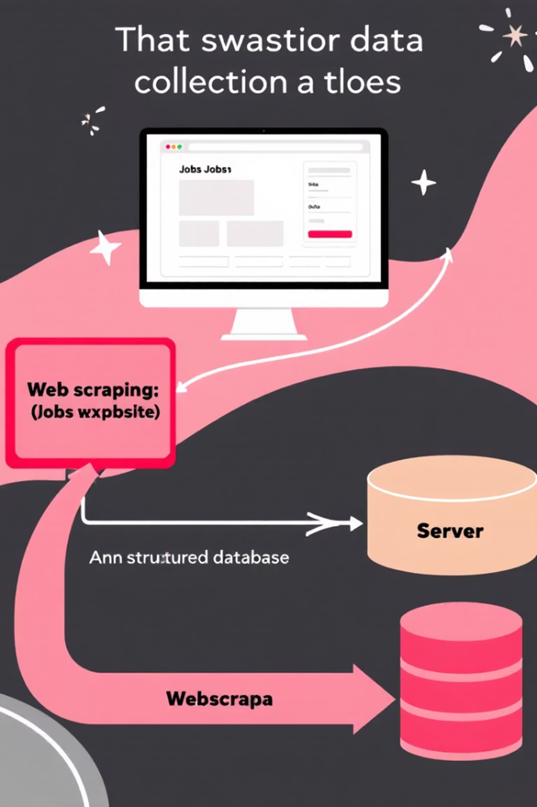
Data Sources & Scope
Collection Tools
Python-based web scraping
Indeed, LinkedIn, Glassdoor platforms
Text normalization techniques
Greater Chicago area focus
Structured data preparation
Entry-level tech positions
Data Fields
Job titles and company names
Automated nudges for inactive students
Required skills and experience
Location and industry data

Slide 22
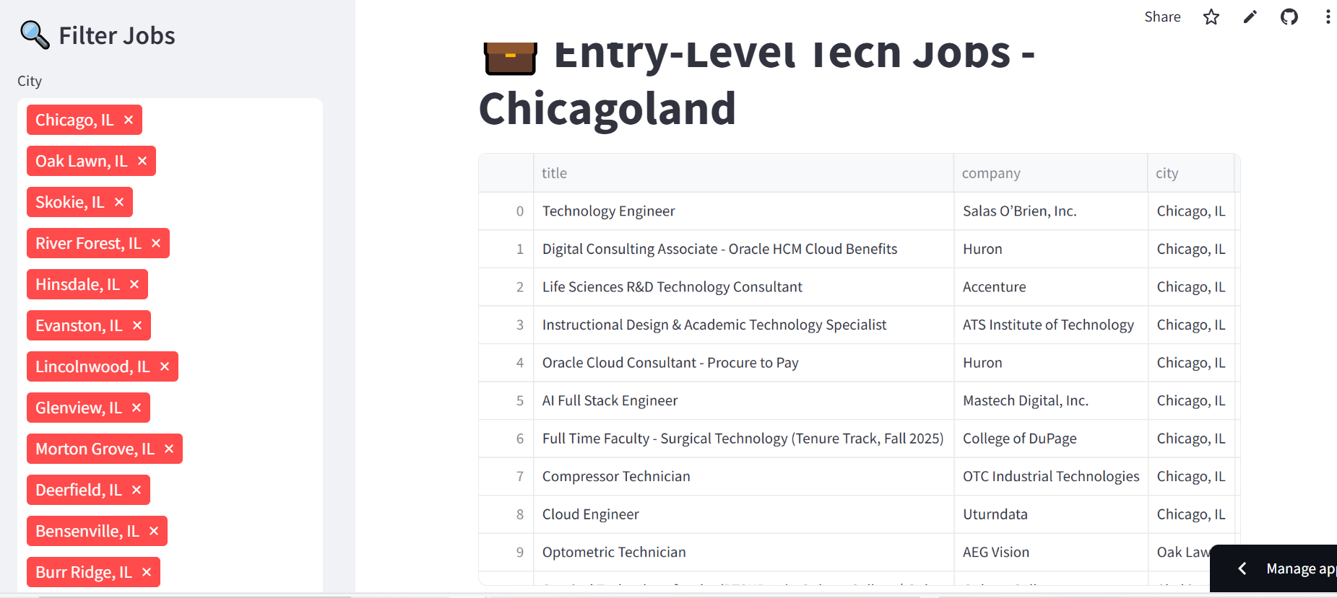




Technical Implementation
https://technology-rolesgit-vfxsssjxqjjtqkn9wsoppx.streamlit.app/
Data Scraping
Extracted job listings using Python libraries across multiple platforms.
Data Cleaning
Standardized job titles and extracted skill keywords from descriptions.
Storage & Processing
Organized data in structured format for analysis.
Dashboard Creation
Built interactive visualization using Streamlit framework.

Slide 23
Any Questions?

Slide 24
Thank you

